Slide 1
IRIS
Recap of 2017-2018
Recruitment Marketing Campaign
And….
Growth, Success & Beyond in 2019

Slide 2
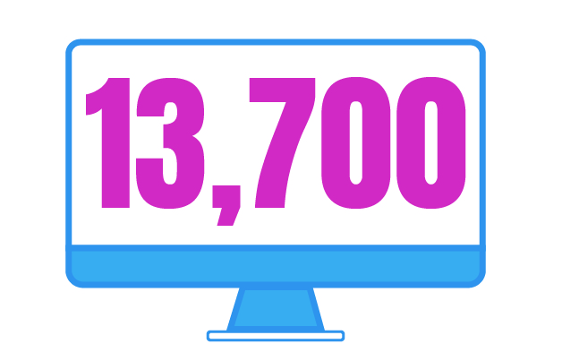
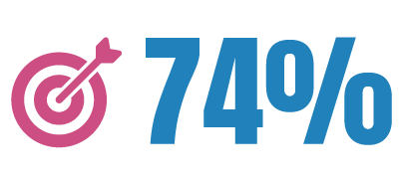
The Results are In…
40% increase in the average monthly number of candidates per UCPath Center job opening
3.6 million views
of UCPath Center digital ads on social media, Google, Pandora and sites across the web
More than 13,700 visits by qualified candidates* to the UCPath online job board (ADP)
74% of strategic candidates reached

Slide 3
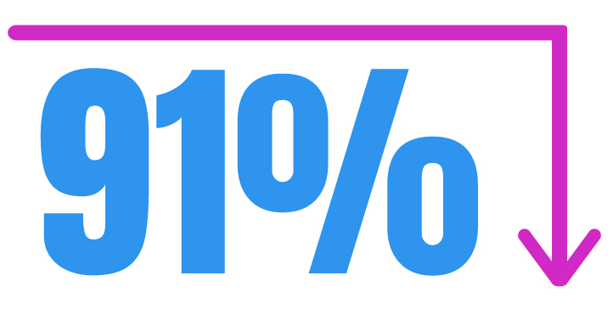
Cost Savings
UCPath Center
91% cost reduction in “cost-per-click" to the UCPath job board (2017-2018)
Beacons Point Monthly Retainer "Cost to Click“ to UCPath Job Board (ADP)
September 2017 |  | $‎ 50.68
September 2018 |  | $‎ 4.36
Delta |  | -91.4%
*Data calculated based on monthly retainer fee cost per total monthly clicks to the online job board (ADP). See appendix for month-over-month breakdown.

Slide 4
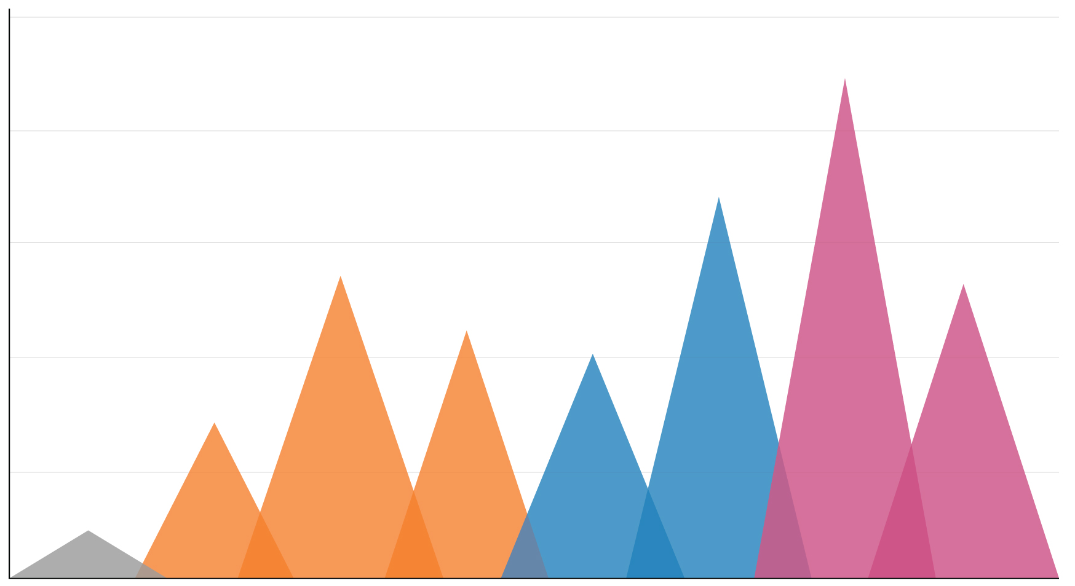
2018 Total: 5,661
Application Peaks 2018
1,500
1,315
1,200
1,003
900
790
777
651
600
590
408
300
127
Feb
Mar
Apr
May
Jun
Jul
Aug
Sep
Billboards, Bus Ads & Digital Ads
Digital Ads
Billboards, Bus Ads, Digital Ads & Radio Ads
Campaign Articles and Social Media Posts
Notes:
Feb: 127
March: 408
April: 790
May: 651
June: 1003
July: 1003
Aug 1315
Sept. 777
Total: 5,661

Slide 5
Even More Results
UCPath Center
Attracted approximately 33,000 visitors to the UCPathJobs.org
Campaign videos generated more than 3,300 views
Built a following of approximately 2,300 new people on social media
Established the UCPath Center as an exciting employer in Riverside that is independent from UC Riverside

Slide 6
Want to see more?

Slide 7
Past Challenges 2015-2017
The UCPath Center had a few serious recruitment problems….
No UCPath brand identity
No UCPath recruitment website
Small number of candidates per job opening
Confusion about who we are /what we did for UC (confusion with UCR especially)
No strategic recruitment efforts
Outdated and ad hoc recruitment materials
No strategic online presence or messaging
Minimal and ad hoc social media presence
We changed all of that…

Slide 8
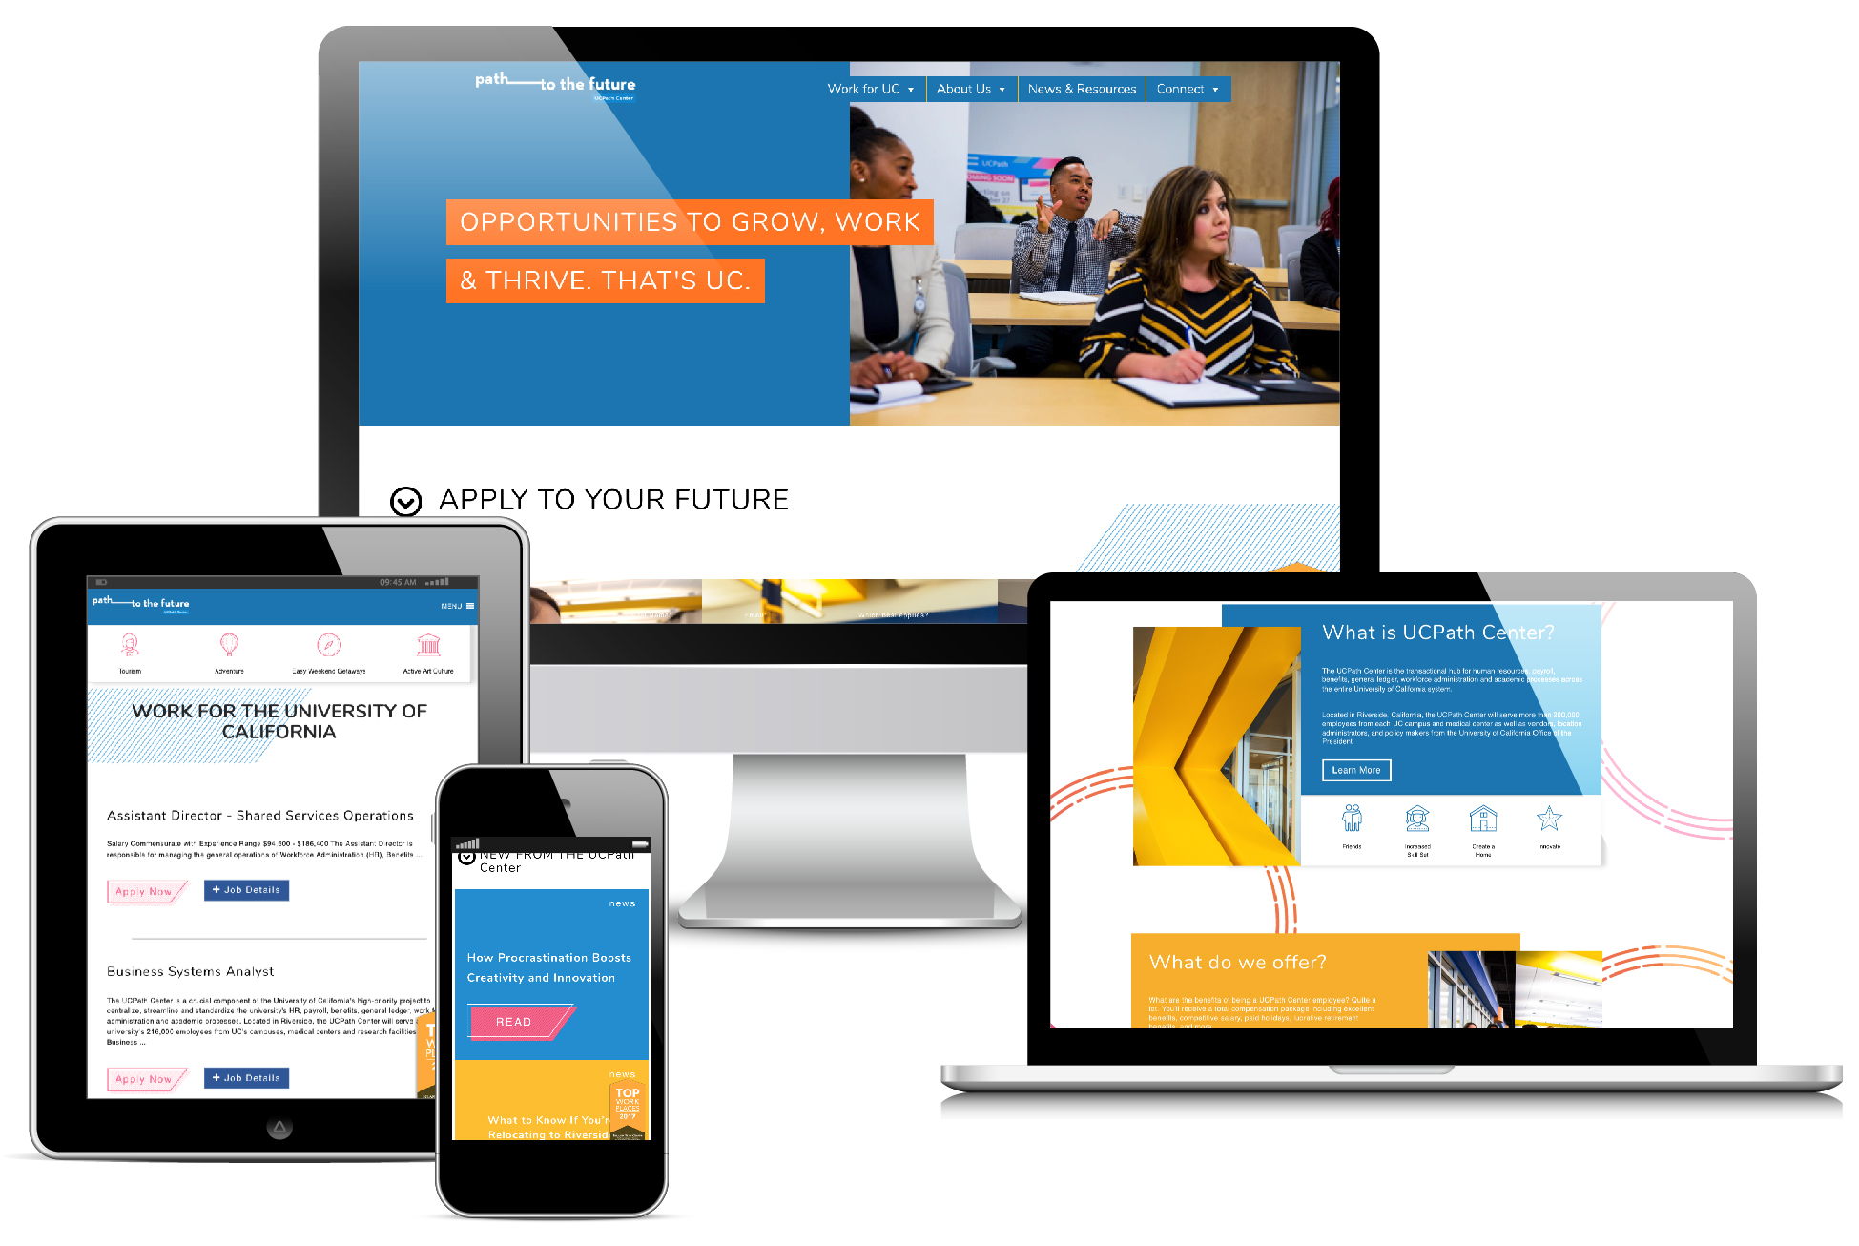
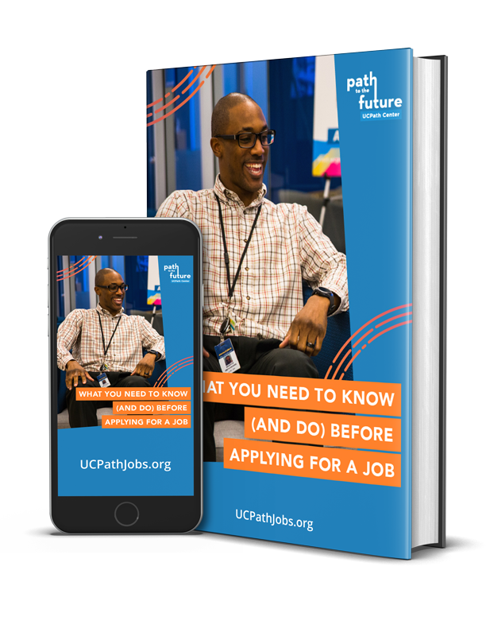
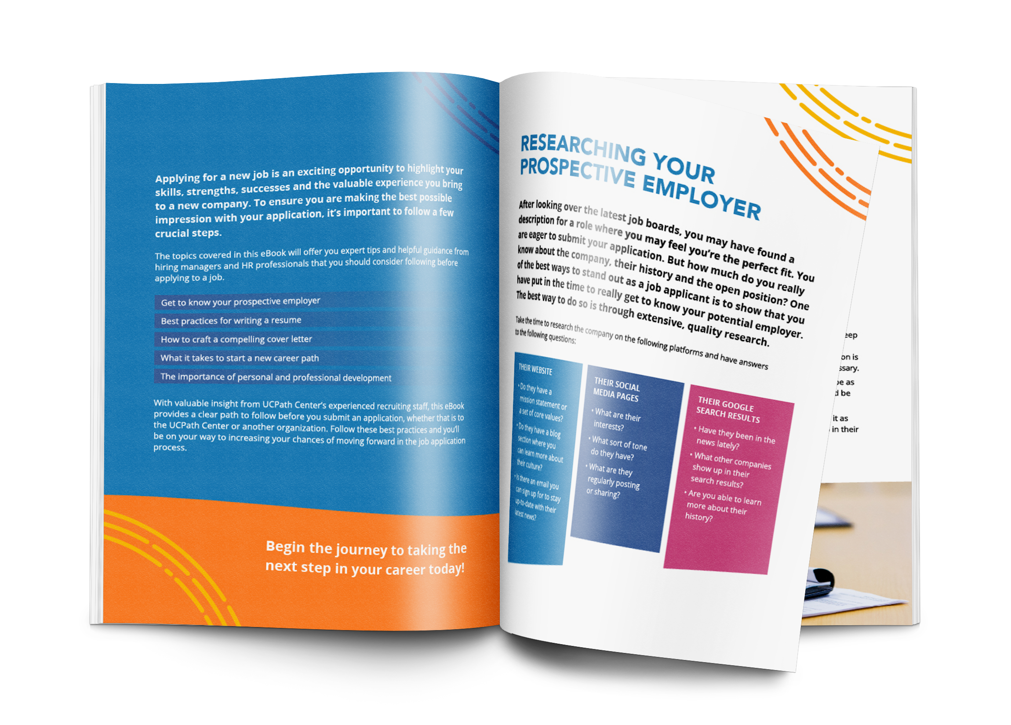
In 2017, the UCPath Center developed and executed an ambitious marketing campaign to attract qualified candidates committed to making a difference at UC.
Here’s how we did it.
Established a unique identity and built an online destination for the UCPath Center
Attracted interested, qualified candidates with relevant, timely content
Powered an effective marketing campaign reaching more than 3.6 million people using a mix of digital and traditional public relations and advertising opportunities to promote open jobs, the UCPath Center culture and the University of California as a whole

Slide 9
2017-2018
….. a wildly successful campaign

Slide 10
Today, it's important to tell a consistent story across multiple media platforms.
This is currently referred to as transmedia storytelling.
It means our story needs to be shared consistently on our own website, Facebook, LinkedIn, Twitter, Google+ as well as in different formats including videos on YouTube.
By doing so, we amplify our voice and presence wherever our customers and our stakeholders are. This reflects the reality of our audience today and the way they process information.
This is what we did for the UCPath Center throughout the 2017-2018 marketing campaign.

Slide 11
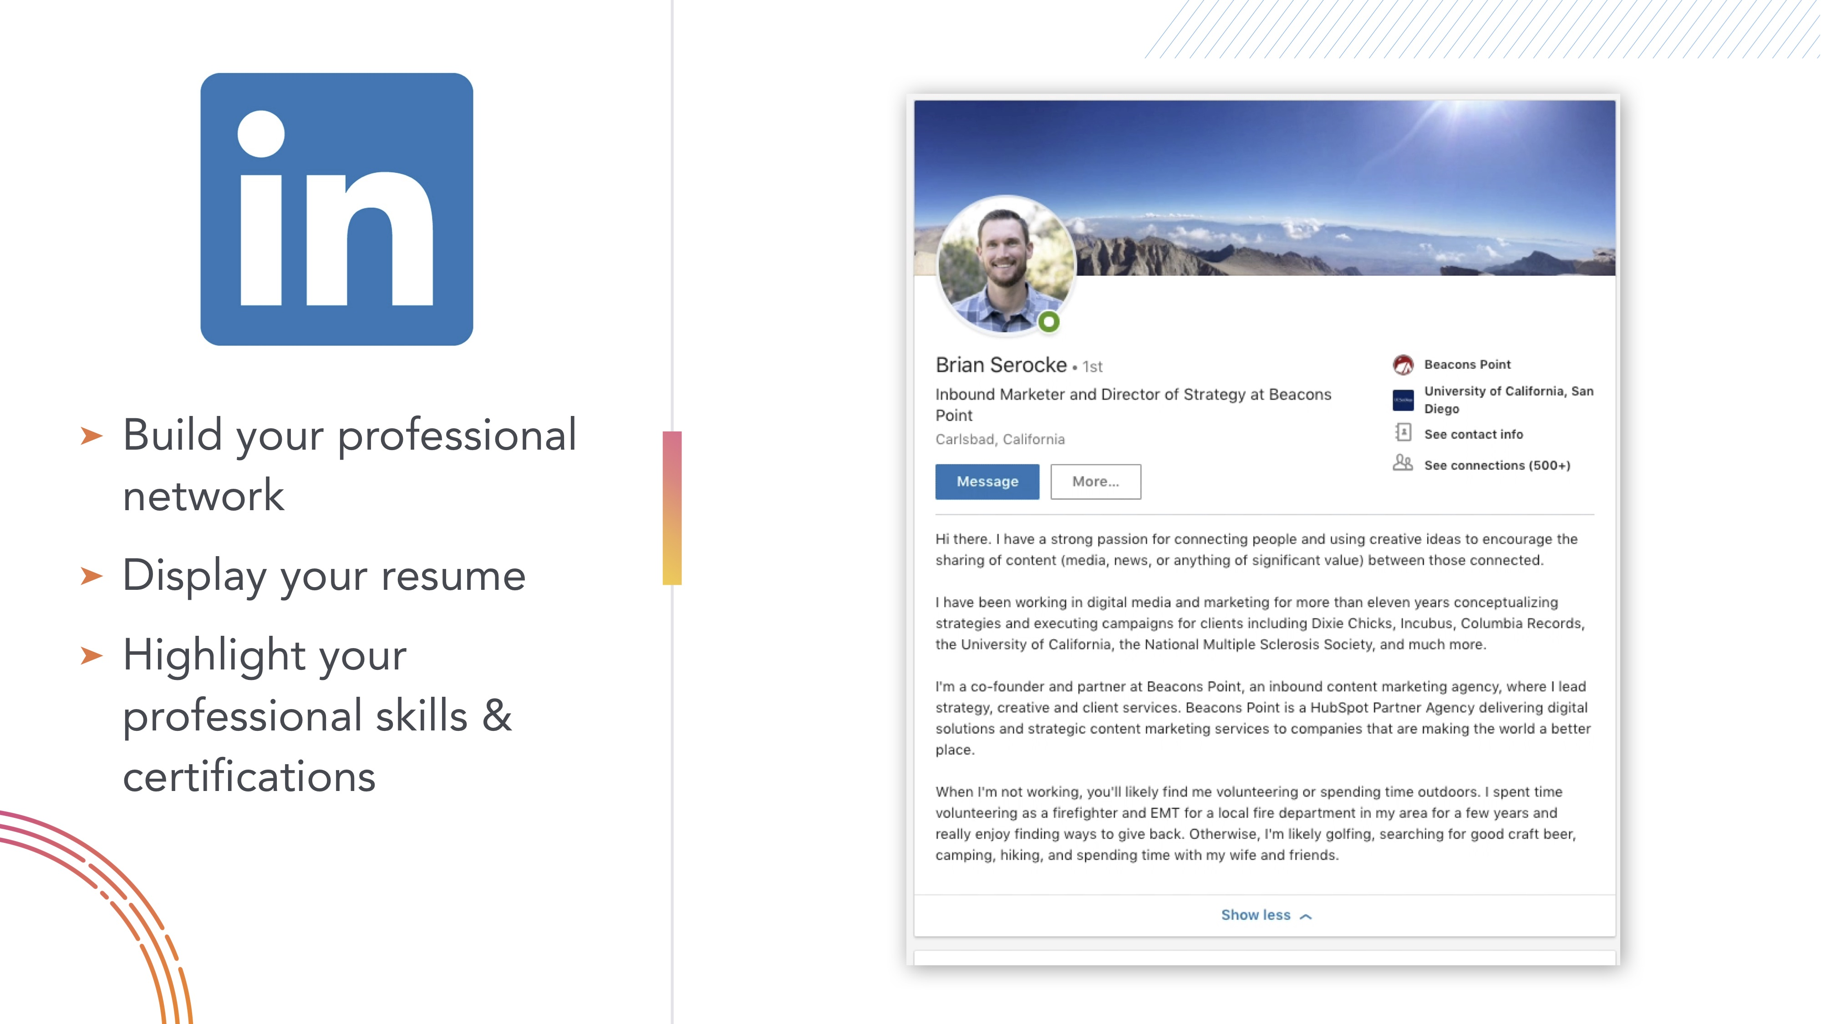
What We Did - Branding and Communications
Created a separate, unique brand identity for the UCPath Center and the recruitment campaign
Built the online home for the UCPath Center on the web at UCPathJobs.org
Trained & Certified UCPath Center employees on social media best practices

Slide 12
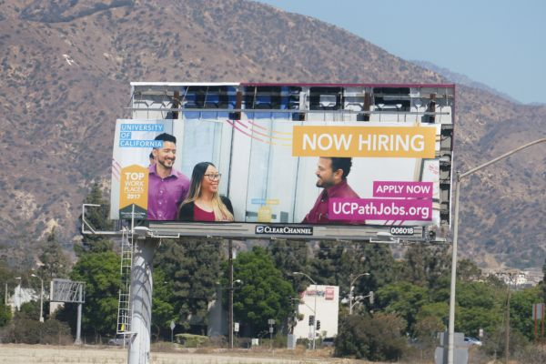
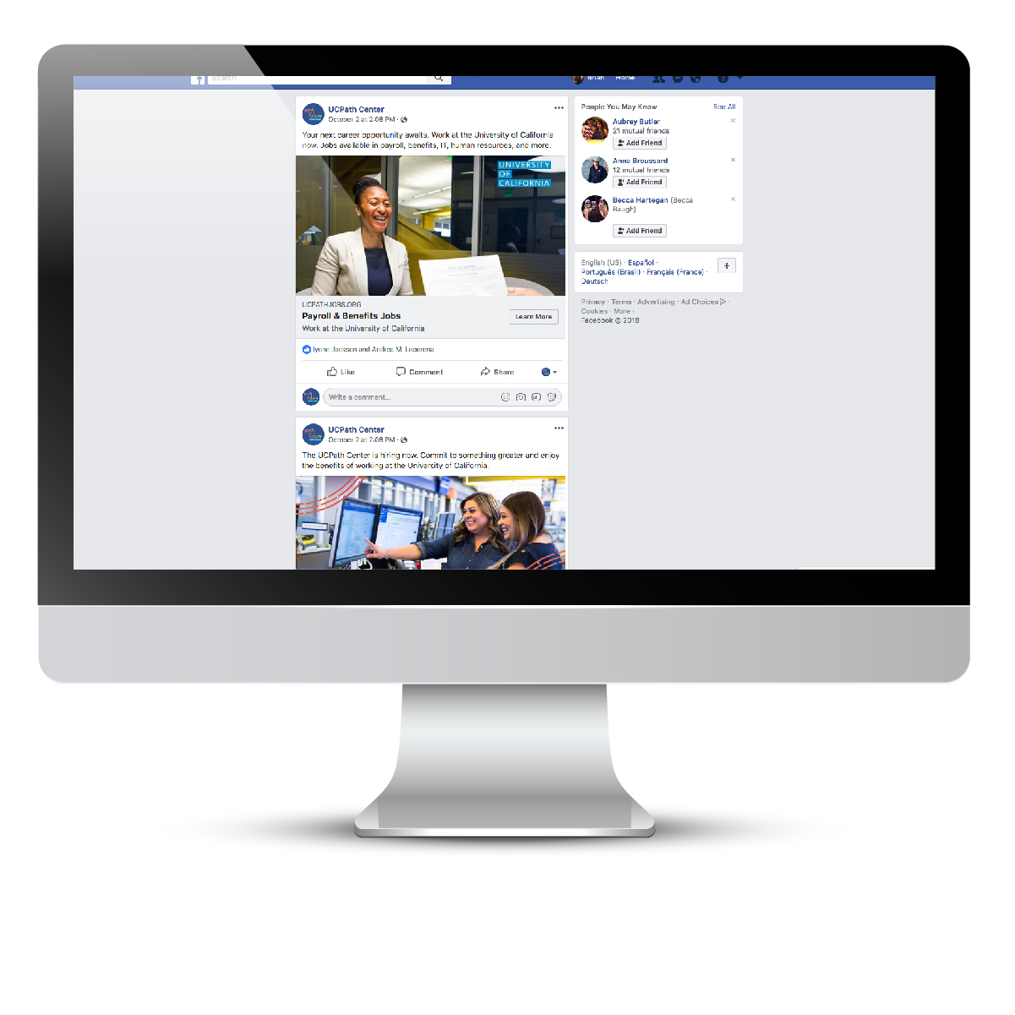
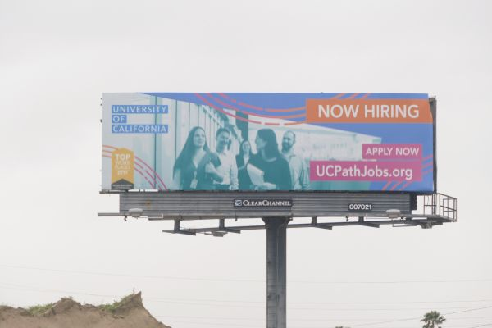
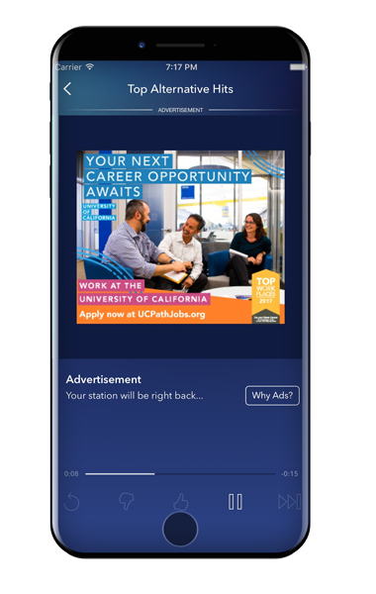
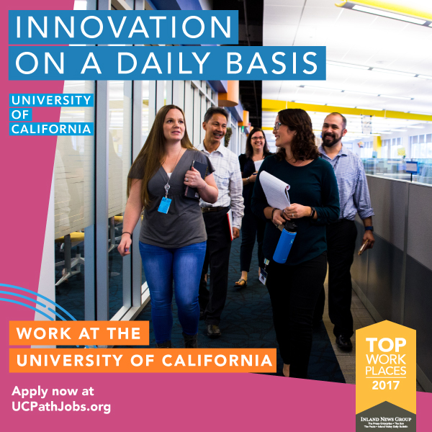
What We Did - Advertising
Designed engaging billboards and bus advertisements for distribution around Southern California
Executed a targeted digital media buy advertising campaign across social media, Google, display banner ads and Pandora digital radio
Advised and consulted on radio advertising scripts, recording and production

Slide 13
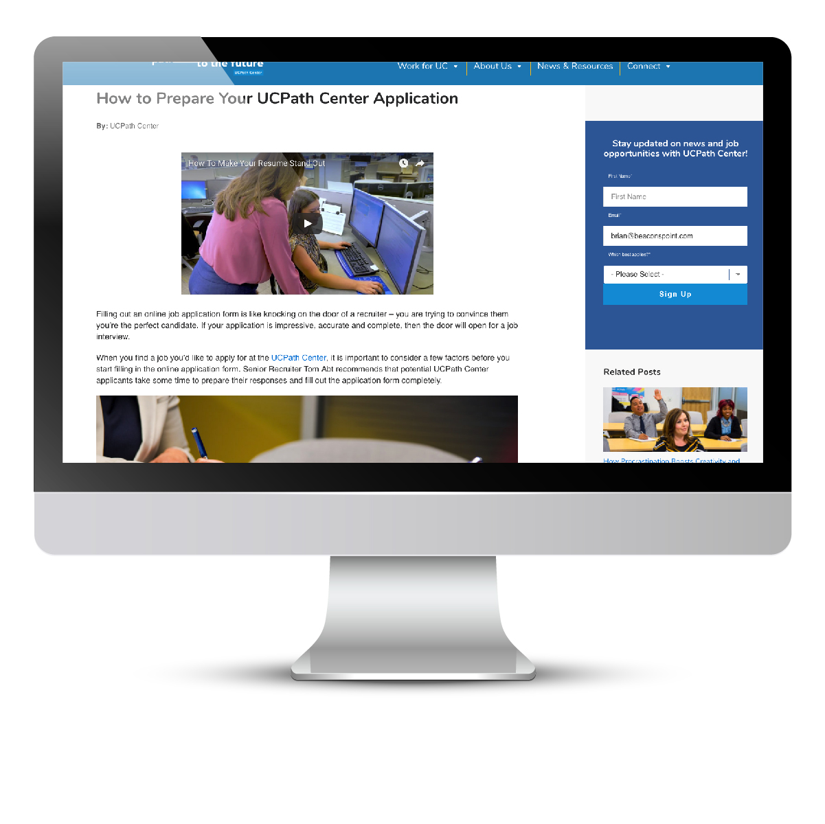
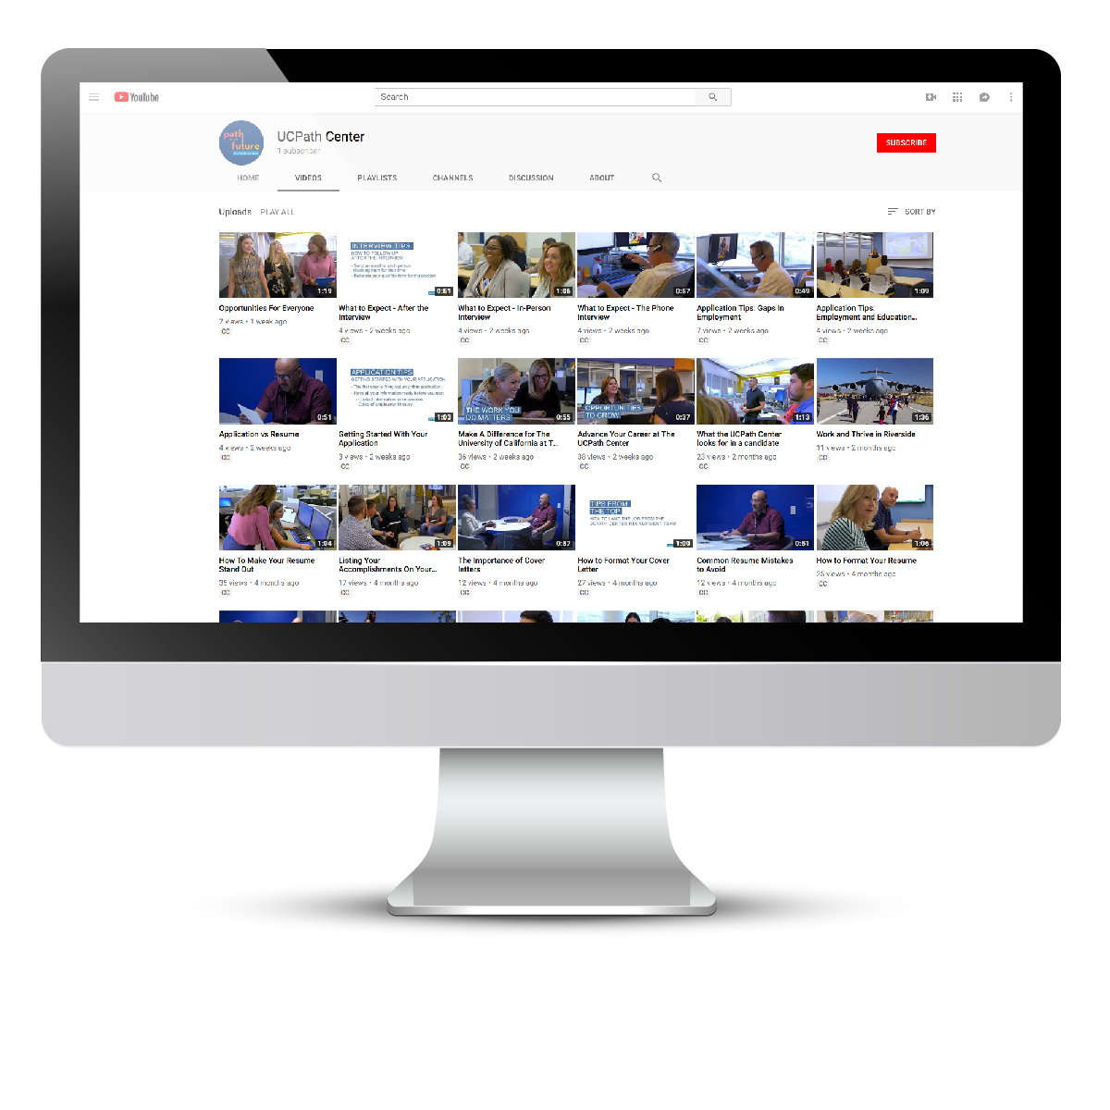
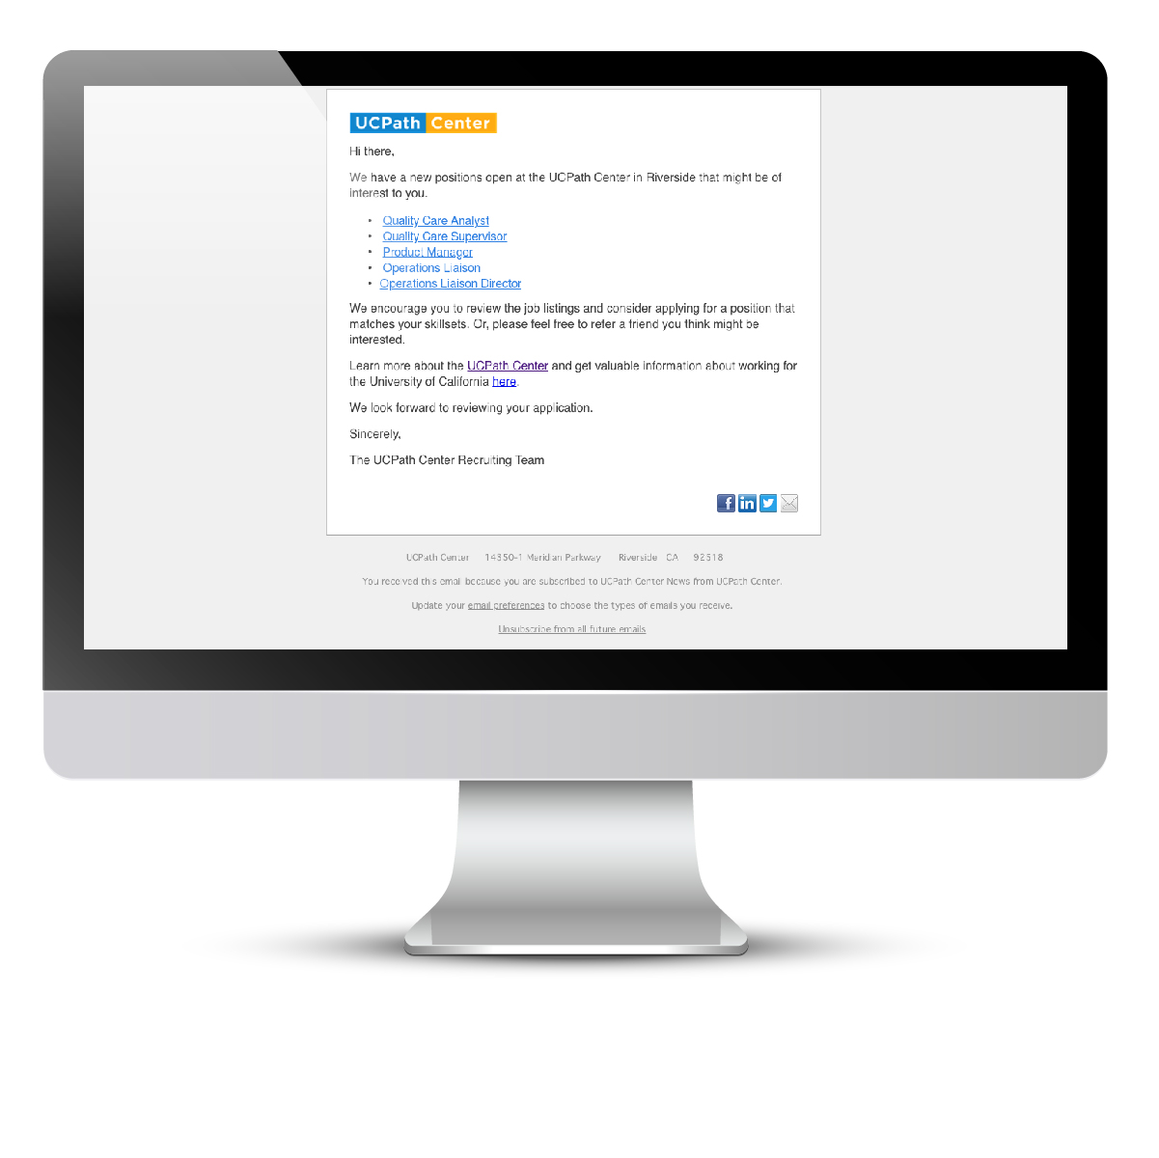
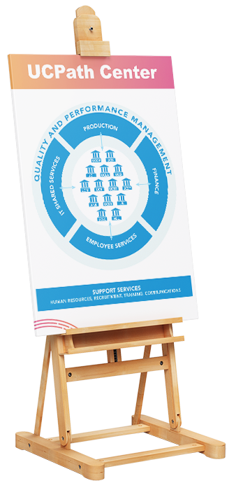
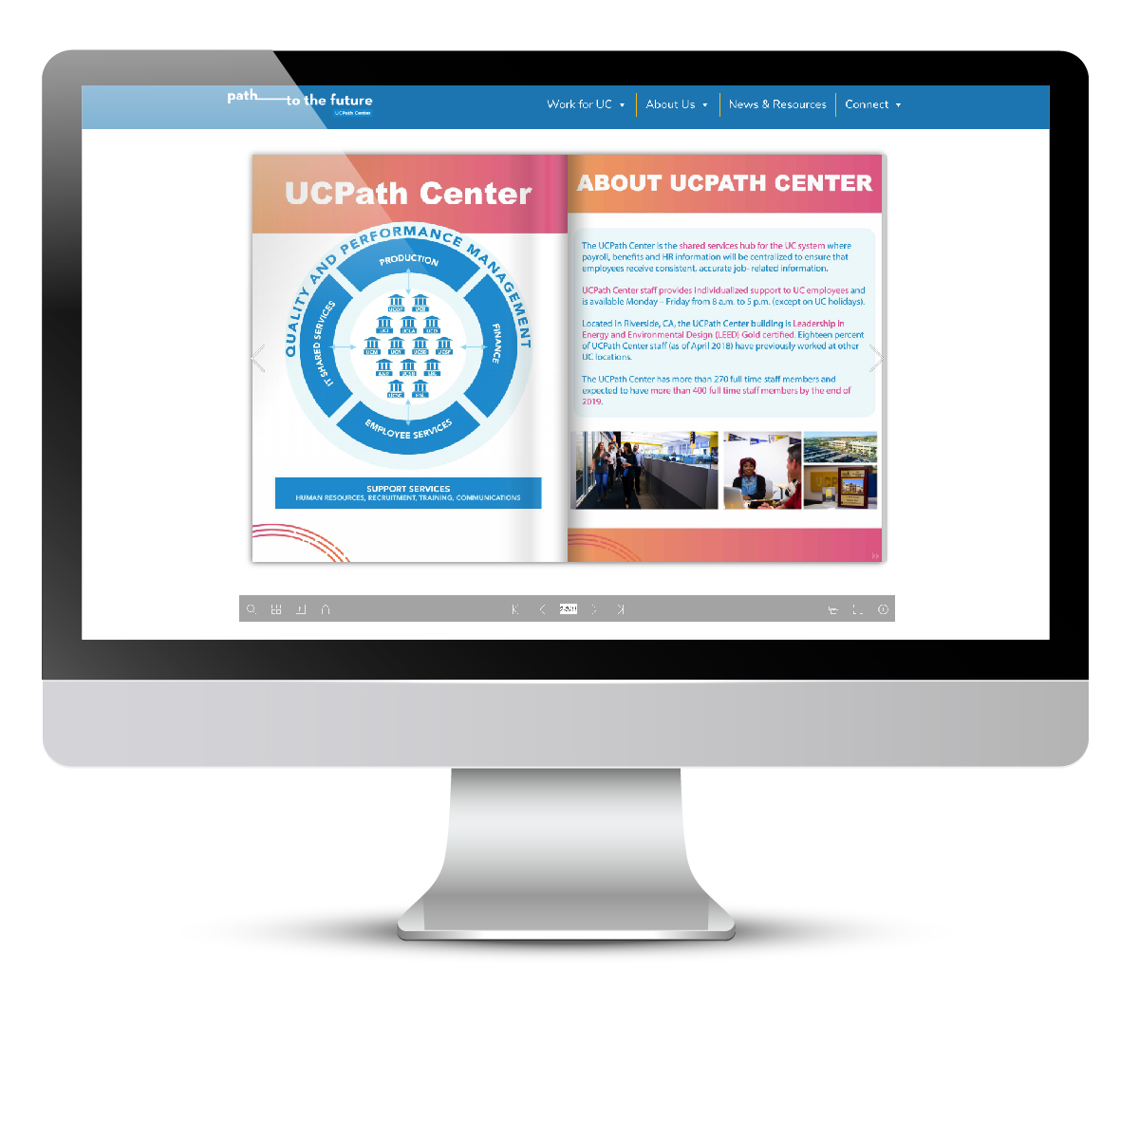
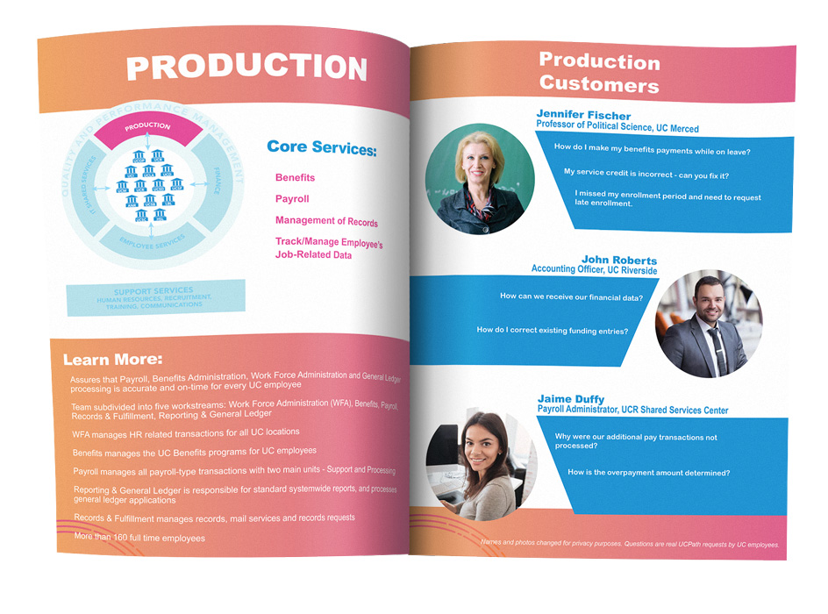
What We Did - Content
Published more than 45 articles and a 13-page eBook providing candidates insights on why they should work at the UCPath Center
Produced more than 27 videos about the benefits of working at the UCPath Center and living in the Southern California region
Published more than 700 posts on all UCPath Center social media outlets
Sent approximately 2,800 targeted emails to interested job candidates
Created a digital “view book” for internal UCPath Center and UC communications
Designed the “A Look Inside the UCPath Center” book and posters for UC-systemwide distribution
Shot and edited custom, original high-resolution branded photography of the UCPath Center offices and staff

Slide 14
What We Did – Radio Ads
“Are you tired of the commute, looking to make a career change or want to make a difference in higher education? The UCPath Center in Riverside is hiring and we want you to join our team.
At the UCPath Center, we’re providing payroll and human resources services for more than 200 thousand UC employees. If you have a passion for public service and making a difference, apply today to start your career at the University of California.
We are currently hiring qualified candidates in the areas of payroll, information technology, benefits, customer service, Human Resources and more! Named a Top Workplace award by Press Enterprise, the UCPath Center offers employees a full range of benefits and the opportunity to grow and succeed. Working at UC means being a part of a vibrant institution that’s making things better for individuals, for California, for the world. Visit UCPathJobs.org. That’s UCPathJobs.org. Passionate people serve a greater good.
That’s UC.”

Slide 15
What We Did – Radio Ads
“Support for KVCR comes from the UCPath Center in Riverside, the shared services center for the University of California, which provides payroll and human resources services for more than 200 thousand UC employees. Career opportunities can be found at UCPathJobs.org.”

Slide 16
What are
people saying?
Word on the street is…

Slide 17
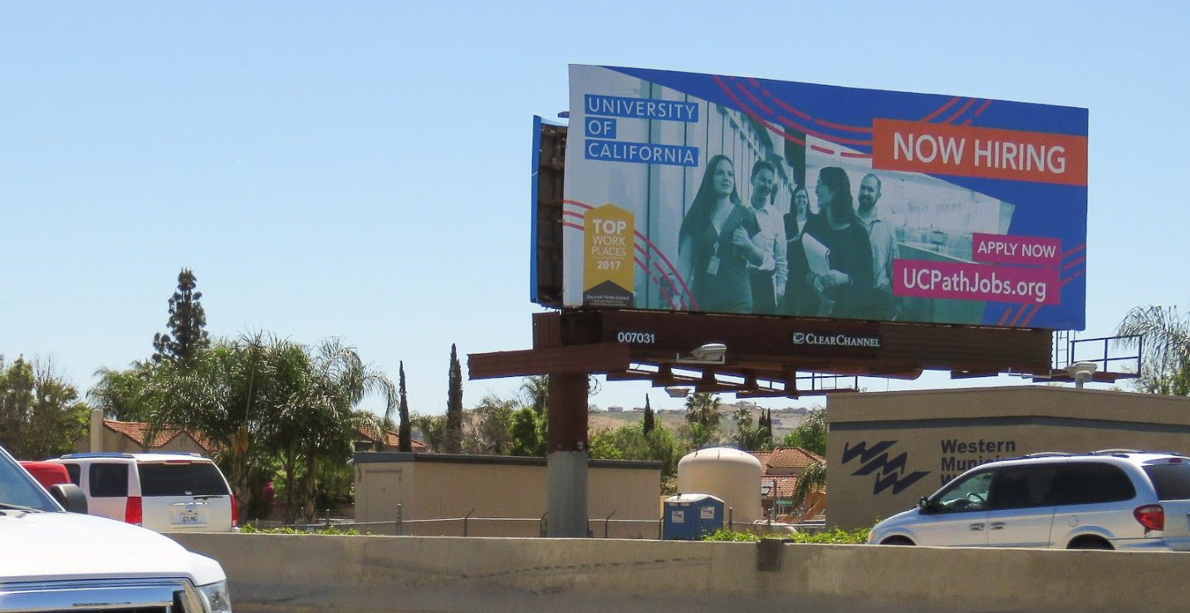
About Our Billboard Ads….
“I saw the giant billboard on the 91 freeway and called my friend who’s looking for a payroll job and she immediately applied!”
“I was driving home from Orange County as I have been doing for 5 years. I saw the billboard and applied. I’m no longer commuting and got back two hours of my life every work day!”
Are you tired of the commute, looking make a career change or want to make a difference in higher education?

Slide 18
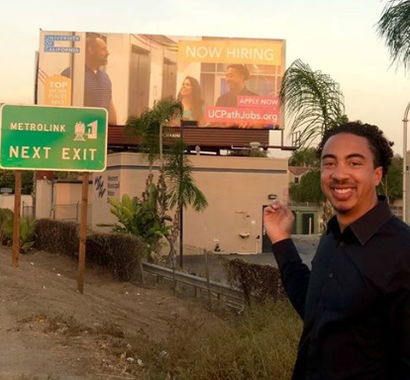
About Our Ads….
“I like the challenges and opportunities I’ve had to expand and grow while working at the UCPath Center.”
– Jordan Trent, UCPath Center ITSS team
The UCPath Center in Riverside is hiring and we want you to join our team. At the UCPath Center, we’re providing payroll and human resources services for more than 200,000 UC employees.

Slide 19
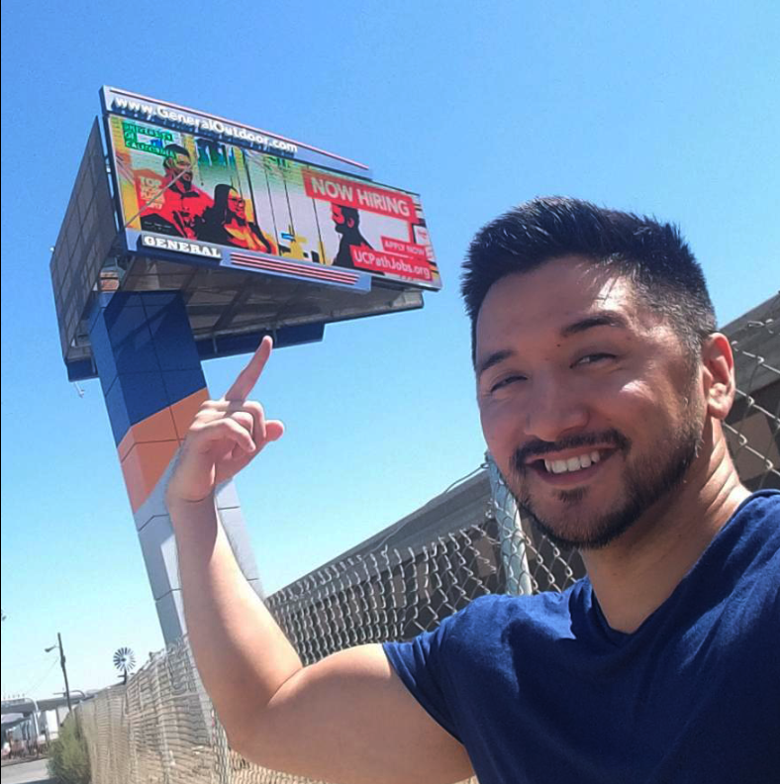
About Our Ads….
“I love working at the UCPath Center with such an awesome group of people.”
- Omar Byon, UCPath Center Payroll team
If you have a passion for public service and making a difference, apply today to start your career at the University of California.

Slide 20
From Our Recruitment Team….
“People say ‘Joe, you’re always on LinkedIn’ when actually, I’m just sharing and liking the UCPath Center posts (created/managed by our marketing vendor), which makes us more well known to an even bigger network.”
“The colorful/well-branded marketing materials, new UCPathJobs.org website, videos and social media posts are all an important part of our recruitment strategy and also being used regularly by the recruitment team to help promote the UCPath Center and draw in potential candidates.”
We are currently hiring qualified candidates in the areas of payroll, information technology, benefits, customer service, Human Resources and more!

Slide 21
What Our Employees Are Saying….
“After reading about the culture and seeing the videos and social media posts, I could tell this was the kind of place where I wanted to be.”
“My former work colleagues work at the UCPath Center and for a year kept trying to tell me to come over. After watching the video about what the UCPath Center does and why, that’s what made me finally apply. I want to be part of something big.”
Named a Top Workplace award by Press Enterprise, the UCPath Center offers employees a full range of benefits and the opportunity to grow and succeed. Working at UC means being a part of a vibrant institution that’s making things better for individuals, for California, for the world.

Slide 22
Establishing the UCPath Center Brand….
“People know who we are now – no doubt. I think the marketing campaign has been a great success.”
“A big change this past year is that people are now able to separate us from UCR. Even at the job fairs – we’re no longer placed next to the schools, they put us by regular employers.”
Visit UCPathJobs.org. That’s UCPathJobs.org. Passionate people serving a greater good. That’s UC.

Slide 23
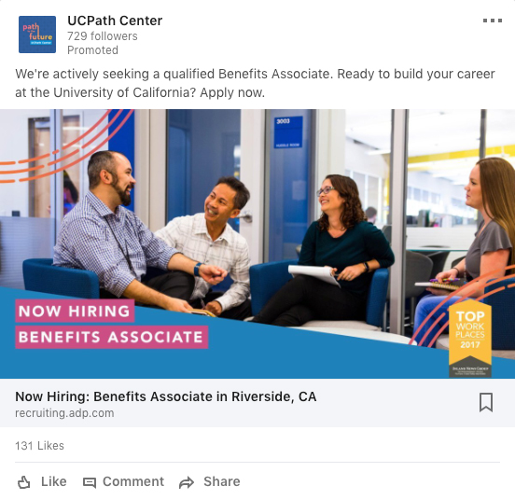
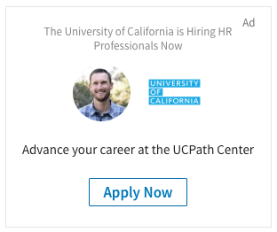
About Our Digital Media Ads….
“I was using LinkedIn as my job search engine searching for a job at a school and saw an online ad that said “Now Hiring.” It took me to the UCPathJobs.org page. When I saw that a prestigious company such as UC had a benefits department – I jumped on it and eventually accepted the job.“
– Zabrina Crespo, UCPath Center Benefits Team

Slide 24
Growth and Success
2019 and beyond
Onwards and upwards!

Slide 25
2019 Campaign Goal
Increase the average number of qualified candidates per UCPath Center job opening by 60% by the end of 2019 by educating and driving candidates to the ADP online job board to apply for an open position.
Notes:
60% = (from 15 to 24)

Slide 26
Why continue in 2019?
Solidify the UCPath Center brand and ensure a consistent, professional, engaging narrative continues to establish the UCPath Center as a top employer in the Southern California region
Target new qualified candidates with more content on in-depth topics such as PeopleSoft and Oracle based on data and campaign performance to support the UCPath Center’s hiring goals
Continue to increase the number of qualified candidates per UCPath Center job opening
Arm the UCPath Center recruitment team with the marketing content necessary to attract top talent
Provide operational and executional support to the UCPath Center HR and Communications teams

Slide 27
More Reasons…..
Consistent and well branded creative design of marketing/press/ communications collateral
Market research for additional communications or advertising initiatives
Brand positioning for internal and external press and public relations communications
Internal UC communications – consistent and well branded creative design of posters, PowerPoint presentations and other collateral requested by the UCPath Center Executive Director and leadership staff

Slide 28
After working with Beacons Point, our marketing vendor, we have streamlined our operational processes over the past year --enabling us to pass those efficiencies to our recruitment team as well as reducing the monthly retainer rate for 2019, while still maintaining and exceeding our performance goals.
Improved
Efficiencies

Slide 29
UCPath Center
2017-2018 Recruitment Marketing Campaign
Portfolio Sample

Slide 30
Website
UCPathJobs.org

Slide 31
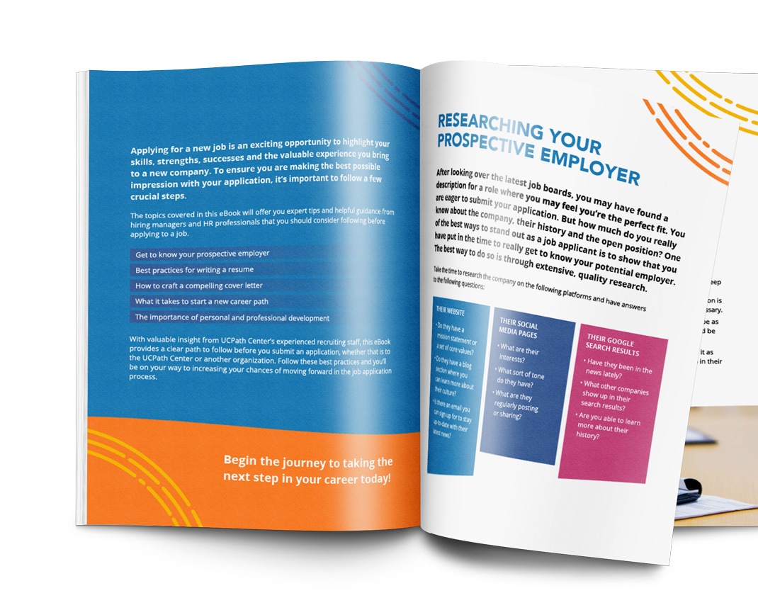
Content
Viewbook
UCPath Center Blog
Application eBook

Slide 32
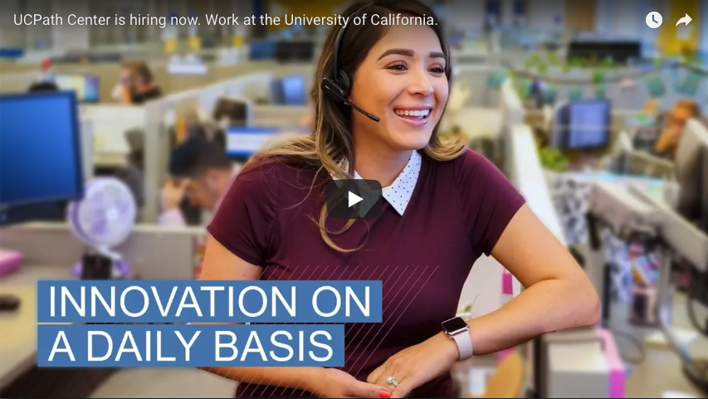
Video
YouTube Channel

Slide 33
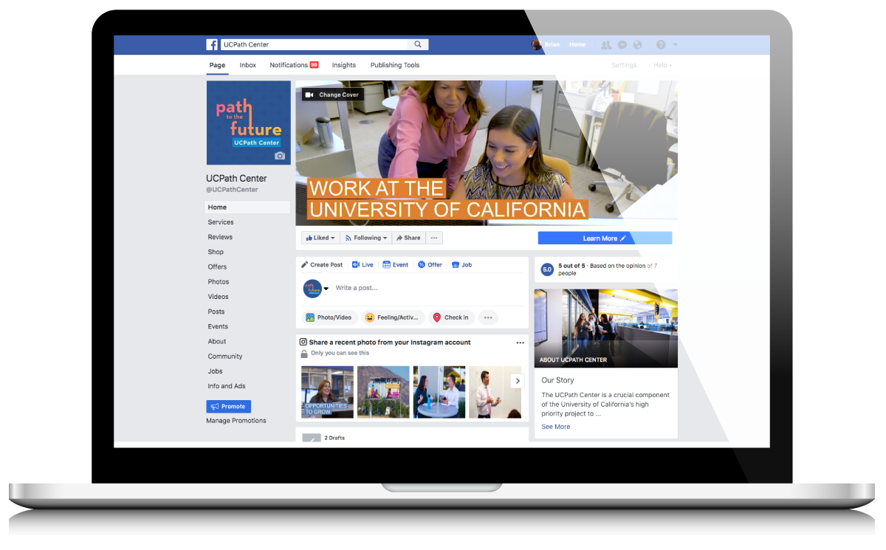
Social Media

Slide 34
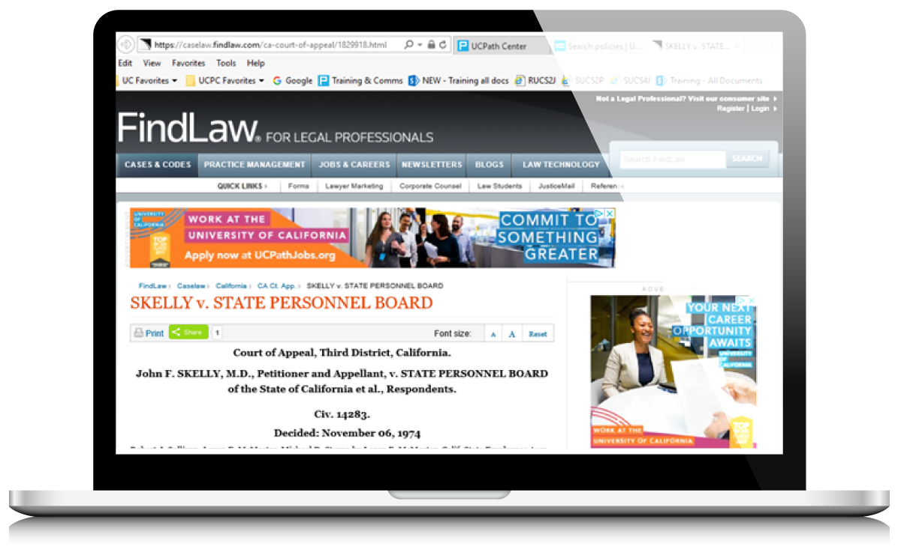
Digital Advertising

Slide 35
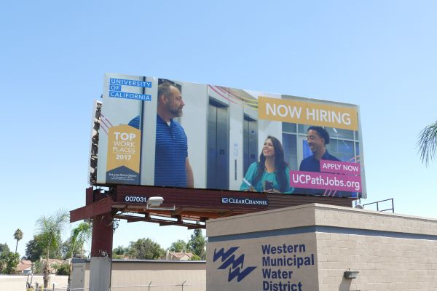
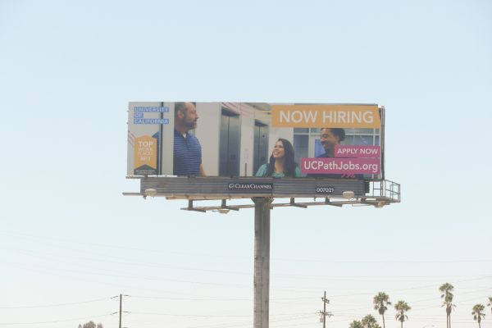
Traditional Advertising

Slide 36
Appendix

Slide 37
UCPathJobs.org Website Visits Year Over Year by Month (Sept. 2017 – Sept. 2018)

Slide 38
Cost Per Click Year Over Year Trending by Month (Sept. 2017 – Sept. 2018)

Slide 39
74% of candidates reached were the top two types of candidates identified as strategic priorities for the campaign
Peter, the Professional
Jessica, the Job Seeker
Based on ideal candidate personas defined with the UCPath Center.
Sample size of 490 candidates.

Slide 40
Cost Per Click Analysis (Sept. 2017 – Sept. 2018)
 | Cost | Clicks to ADP | Cost per Click | Website Sessions | Conversion Rate (Clicks vs Sessions)
All Time (Total Campaign - Includes Branding Fee) | $206,625.00 | 13,620 | $15.17 | 41,363 | 32.93%
All Time (Since Campaign Launch - Retainer Only) | $170,625.00 | 13,620 | $12.53 | 41,363 | 32.93%
2017 September | $13,125.00 | 259 | $50.68 | 872 | 29.70%
2017 October | $13,125.00 | 108 | $121.53 | 495 | 21.82%
2017 November | $13,125.00 | 117 | $112.18 | 419 | 27.92%
2017 December | $13,125.00 | 167 | $78.59 | 685 | 24.38%
2018 January | $13,125.00 | 772 | $17.00 | 1,889 | 40.87%
2018 February | $13,125.00 | 707 | $18.56 | 1,719 | 41.13%
2018 March | $13,125.00 | 724 | $18.13 | 1,712 | 42.29%
2018 April | $13,125.00 | 1,202 | $10.92 | 3,303 | 36.39%
2018 May | $13,125.00 | 2,092 | $6.27 | 6,477 | 32.30%
2018 June | $13,125.00 | 1,182 | $11.10 | 4,643 | 25.46%
2018 July | $13,125.00 | 1,384 | $9.48 | 4,393 | 31.50%
2018 August | $13,125.00 | 1,898 | $6.92 | 5,557 | 34.16%
2018 September | $13,125.00 | 3,008 | $4.36 | 9,199 | 32.70%
Notes: | This is only tracking campaign metrics (clicks to the ADP job board and UCPathJobs.org website traffic) against the Beacons Point monthly retainer fee. Monthly costs not accounted for include the digital advertising media buy and any additional advertising paid for by UCPC (radio ads, billboard/bus ads).

Slide 41
Candidates Per Opening Tracking (Sept. 2017 – Sept. 2018)
 | Candidates | Reqs | Openings | Candidates / Reqs | Candidates / Openings |  |  | Candidates | Reqs | Openings | Candidates / Reqs | Candidates / Openings
2016 |  |  |  |  |  |  | 2017
September | 425 | 7 | 35 | 60.7 | 12.1 |  | September - Campaign Launch | 911 | 6 | 12 | 151.8 | 75.9
October | 225 | 3 | 3 | 75.0 | 75.0 |  | October | 374 | 7 | 8 | 53.4 | 46.8
November | 333 | 1 | 1 | 333.0 | 333.0 |  | November | 473 | 2 | 4 | 236.5 | 118.3
December | 330 | 3 | 8 | 110.0 | 41.3 |  | December | 445 | 1 | 2 | 445.0 | 222.5
2017 |  |  |  |  |  |  | 2018
January | 416 | 4 | 8 | 104.0 | 52.0 |  | January | 210 | 4 | 12 | 52.5 | 17.5
February | 642 | 7 | 7 | 91.7 | 91.7 |  | February | 127 | 3 | 3 | 42.3 | 42.3
March | 1,382 | 9 | 32 | 153.6 | 43.2 |  | March | 408 | 11 | 20 | 37.1 | 20.4
April | 647 | 7 | 10 | 92.4 | 64.7 |  | April | 790 | 1 | 16 | 790.0 | 49.4
May | 1,178 | 5 | 40 | 235.6 | 29.5 |  | May | 651 | 2 | 3 | 325.5 | 217.0
June | 597 | 6 | 13 | 99.5 | 45.9 |  | June | 590 | 4 | 5 | 147.5 | 118.0
July | 477 | 2 | 9 | 238.5 | 53.0 |  | July | 1,003 | 8 | 34 | 125.4 | 29.5
August | 957 | 8 | 29 | 119.6 | 33.0 |  | August | 1,315 | 11 | 15 | 119.5 | 87.7
 | 7,609 | 62 | 195 | 122.7 | 39.0 |  |  | 7,297 | 60 | 134 | 121.6 | 54.5
*Data table supplied by the UCPath Center Recruitment Team.

Slide 42
Blog Posts (45 total posts)
Blog Post Title | Link to Blog Post | Category
How Procrastination Boosts Creativity and Innovation | https://ucpathjobs.org/company-culture/how-procrastination-boosts-creativity-and-innovation/ | Lifestyle
What to Know If You’re Relocating to Riverside | https://ucpathjobs.org/about-riverside/know-youre-relocating-riverside/ | Lifestyle
How to Prepare Your UCPath Center Application | https://ucpathjobs.org/about-ucpath-center/prepare-ucpath-center-application/ | UCPath Center
5 Activities in Riverside Your Family Will Love | https://ucpathjobs.org/about-riverside/5-activities-riverside-family-will-love/ | Lifestyle
How to Make the Most of Your Next Vacation | https://ucpathjobs.org/about-riverside/make-next-vacation/ | Lifestyle
4 Ways to Create Growth Opportunities at the UCPath Center | https://ucpathjobs.org/about-ucpath-center/4-ways-create-growth-opportunities-ucpath-center/ | UCPath Center
UCPath Center Employees Lace Up for UC Walks | https://ucpathjobs.org/about-ucpath-center/ucpath-center-employees-lace-uc-walks/ | UCPath Center
Here’s What It Means to be a Top Workplace at the UCPath Center | https://ucpathjobs.org/about-ucpath-center/heres-means-top-workplace-ucpath-center/ | UCPath Center
The Best Hikes to Explore in Riverside | https://ucpathjobs.org/about-riverside/best-hikes-explore-riverside/ | Lifestyle
How UC Contributes to Saving Energy and Improving Sustainability in California | https://ucpathjobs.org/sustainability/uc-contributes-saving-energy-improving-sustainability-california/ | UCPath Center
How to Follow Up on an Application with the UCPath Center | https://ucpathjobs.org/about-ucpath-center/follow-application-ucpath-center/ | Employment Search
UCPath Center Honored with the 2018 Beautification Award | https://ucpathjobs.org/about-ucpath-center/ucpath-center-honored-2018-beautification-award/ | UCPath Center
How to Find the Right Work-Life Balance | https://ucpathjobs.org/about-ucpath-center/find-right-work-life-balance/ | Lifestyle
Explore These Top Riverside Neighborhoods | https://ucpathjobs.org/about-riverside/explore-top-riverside-neighborhoods/ | Lifestyle
How to Celebrate Earth Day Everyday | https://ucpathjobs.org/lifestyle/celebrate-earth-day-every-day/ | Lifestyle
Get to Know The Top-Rated Riverside Schools | https://ucpathjobs.org/about-riverside/get-know-top-rated-riverside-schools/ | Lifestyle
How to Make the Strongest Impression in the UCPath Center Interview | https://ucpathjobs.org/about-ucpath-center/make-strongest-impression-ucpath-center-interview/ | Employment Search
3 Tips to Spring Clean Your Work Life | https://ucpathjobs.org/about-ucpath-center/3-tips-spring-clean-work-life/ | Lifestyle
5 Important Reasons to Love Your Job and Colleagues | https://ucpathjobs.org/about-ucpath-center/5-important-reasons-love-job-colleagues/ | Lifestyle
4 Resume Tips to Get Your Foot in the Door | https://ucpathjobs.org/about-ucpath-center/4-resume-tips-get-foot-door/ | Employment Search
How to Spring Clean Your Life | https://ucpathjobs.org/work-life-balance/spring-clean-life/ | Lifestyle
The Top 5 Ergonomic Tips You Need To Know | https://ucpathjobs.org/about-ucpath-center/top-5-ergonomic-tips-need-know/ | Lifestyle
How to Spend Your Weekend in Riverside | https://ucpathjobs.org/about-riverside/spend-weekend-riverside/ | Lifestyle
How Workplace Diversity is Beneficial at the UCPath Center | https://ucpathjobs.org/about-ucpath-center/workplace-diversity-beneficial-ucpath-center/ | UCPath Center

Slide 43
Blog Posts continued (45 total posts)
Blog Post Title | Link to Blog Post | Category
4 Way to Fit in Fitness at Work | https://ucpathjobs.org/about-ucpath-center/4-ways-fit-fitness-work/ | Lifestyle
2018 Tech Trends in HR to Watch | https://ucpathjobs.org/about-ucpath-center/2018-tech-trends-hr-watch/ | UCPC
3 Simple Ways to Volunteer and Give Back in Riverside | https://ucpathjobs.org/about-riverside/3-simple-ways-volunteer-give-back-riverside/ | Lifestyle
4 Unexpected Discoveries from UC | https://ucpathjobs.org/lifestyle/4-unexpected-discoveries-uc/ | UCPC
How Workplace Culture Breeds Happy Employees | https://ucpathjobs.org/about-ucpath-center/workplace-culture-breeds-happy-employees/ | Lifestyle
Getting into Human Resources without an HR Degree | https://ucpathjobs.org/human-resources/getting-human-resources-without-hr-degree/ | UCPC
How to Craft a Cover Letter that Will Make an Impression | https://ucpathjobs.org/cover-letters/craft-cover-letter-will-make-impression/ | Employment Search
5 Professional New Year’s Resolutions for 2018 | https://ucpathjobs.org/employment-search/5-professional-new-years-resolutions-2018/ | Lifestyle
12 Things UC Achieved in 2017 That You May Not Know About | https://ucpathjobs.org/working-at-uc/12-things-uc-achieved-2017-may-not-know/ | UCPC
Transitioning to a Civilian Career: Veterans at the UCPath Center | https://ucpathjobs.org/about-ucpath-center/transitioning-civilian-career-veterans-ucpath-center/ | UCPC
What Makes The UCPath Center’s Finance Department So Unique? | https://ucpathjobs.org/about-ucpath-center/makes-ucpath-centers-finance-department-unique/ | UCPC
UCPath Center Named a Top Workplace for 2017 | https://ucpathjobs.org/about-ucpath-center/ucpath-center-named-top-workplace-2017/ | UCPC
4 Crucial Steps to Landing The Job | https://ucpathjobs.org/applications/4-crucial-steps-landing-job/ | Employment Search
Six Places You Can Visit In Under Sixty Minutes (From Riverside County) | https://ucpathjobs.org/about-riverside/six-places-can-visit-sixty-minutes-riverside-county/ | Lifestyle
Transform Your Job into a Career at UCPath Center | https://ucpathjobs.org/about-ucpath-center/transform-job-career-ucpath-center/ | Employment Search
Getting in the Holiday Spirit - Riverside Style | https://ucpathjobs.org/about-riverside/getting-holiday-spirit-riverside-style/ | Lifestyle
Monica Johnson, from the Peace Corps to the UCPath Center | https://ucpathjobs.org/working-at-uc/monica-johnson-peace-corps-ucpath-center/ | UCPC
Making Energy Where the Sun Shines: Solar Energy System Installed at UCPath Center | https://ucpathjobs.org/sustainability/making-energy-sun-shines-solar-energy-system-installed-ucpath-center/ | UCPC
The UCPath Center is Hiring. Here’s Why You Should Work Here | https://ucpathjobs.org/about-ucpath-center/ucpath-center-hiring-work-uc/ | Employee Search
10 Common Resume Mistakes and How to Avoid Them | https://ucpathjobs.org/resumes/10-common-resume-mistakes-and-how-to-avoid-them/ | Employment Search
How to Land a Job at the University of California | https://ucpathjobs.org/working-at-uc/how-to-land-a-job-at-the-university-of-california/ | Employee Search
Considering Relocating for a Job? Here’s What You Need to Know | https://ucpathjobs.org/career-opportunities/considering-relocating-for-a-job-heres-what-you-need-to-know/ | Lifestyle
When’s the Best Time for a Job Change | https://ucpathjobs.org/career-opportunities/whens-best-time-job-change/ | Employment Search

Slide 44
Videos (27 total videos)
Video Title | Link to Video
Identify Your Niche at The UCPath Center | https://www.youtube.com/watch?v=_aAJlLMpSwA
Work/Life Balance as a Priority | https://www.youtube.com/watch?v=aYMGvpAwL9U
Opportunities for Growth at The UCPath Center | https://www.youtube.com/watch?v=E5YALGglSTU
Working For The University of California | https://www.youtube.com/watch?v=9CYDYzZyGpc
Build Your Experience at The UCPath Center | https://www.youtube.com/watch?v=nAgwXq3jXa8
The UCPath Center Work Culture | https://www.youtube.com/watch?v=XeV1XWhwP9g
Working for The UCPath Center | https://www.youtube.com/watch?v=jzwm7H8QtNY
Helping UCPath Center Employees Succeed | https://www.youtube.com/watch?v=yiEZgQNR95E
UCPath Center Receives the Riverside Beautification Award | https://www.youtube.com/watch?v=Ekiwhg5lUjc
Make an Impact at The UCPath Center | https://www.youtube.com/watch?v=7WSlx6emT_I
UCPath Center Honored with the Top Workplace Award | https://www.youtube.com/watch?v=RiOGprprtGA
The UCPath Center’s Collaborative Culture | https://www.youtube.com/watch?v=Bi1gFXGNBNY
A Look Inside the UCPath Center’s Engaging Culture | https://www.youtube.com/watch?v=lugLz6ac25w
The Benefits of Working at the UCPath Center | https://www.youtube.com/watch?v=96-OYJL8mag
Why You Should Work in Riverside | https://www.youtube.com/watch?v=XH4sapeyCTQ
How to Make Your Cover Letter Stand Out | https://www.youtube.com/watch?v=h2zEqM85BEY
Video Title | Link to Video
How to Format Your Resume | https://www.youtube.com/watch?v=qW2baE4YJU8
Common Resume Mistakes | https://www.youtube.com/watch?v=KtgT_S79tgE
How to Format Your Cover Letter | https://www.youtube.com/watch?v=ssFgZe_38bI
The Importance of Cover Letters | https://www.youtube.com/watch?v=Sf2FXfOR00g
Listing Your Accomplishments On Your Resume | https://www.youtube.com/watch?v=H_FZDgeaCzM
How to Make Your Resume Stand Out | https://www.youtube.com/watch?v=wgk8b0HVDME
Work and Thrive in Riverside | https://www.youtube.com/watch?v=MqnBIa0j7Zg
What the UCPath Center Looks for in a Candidate | https://www.youtube.com/watch?v=dDav8GcRqaM
Advance Your Career at the UCPath Center | https://www.youtube.com/watch?v=gZzqIZOSorg
Make a Difference for the University of California at the UCPath Center | https://www.youtube.com/watch?v=xQneCpcWCXQ
Getting Started With Your Application | https://www.youtube.com/watch?v=utRkRpW8oYY
Application vs Resume | https://www.youtube.com/watch?v=6ZYjeg_HTbg
Application Tips: Employment and Education History | https://www.youtube.com/watch?v=LB4CftFBI9U
Application Tips: Gaps In Employment | https://www.youtube.com/watch?v=xj7z_fS3KJw
What to Expect: The Phone Interview | https://www.youtube.com/watch?v=eH7KFF8Op4w
What to Expect: The In-Person Interview | https://www.youtube.com/watch?v=e3LkRy0mJgo

Slide 45
Here’s to our continued success in 2019!

